Slide 1
Wireless N Exterior Access Point DAP-3310 / DAP-3410
* Note: competitive information supplied in this document is only there to be used as a comparison guide and not intended to be harmful or misleading.

Slide 2
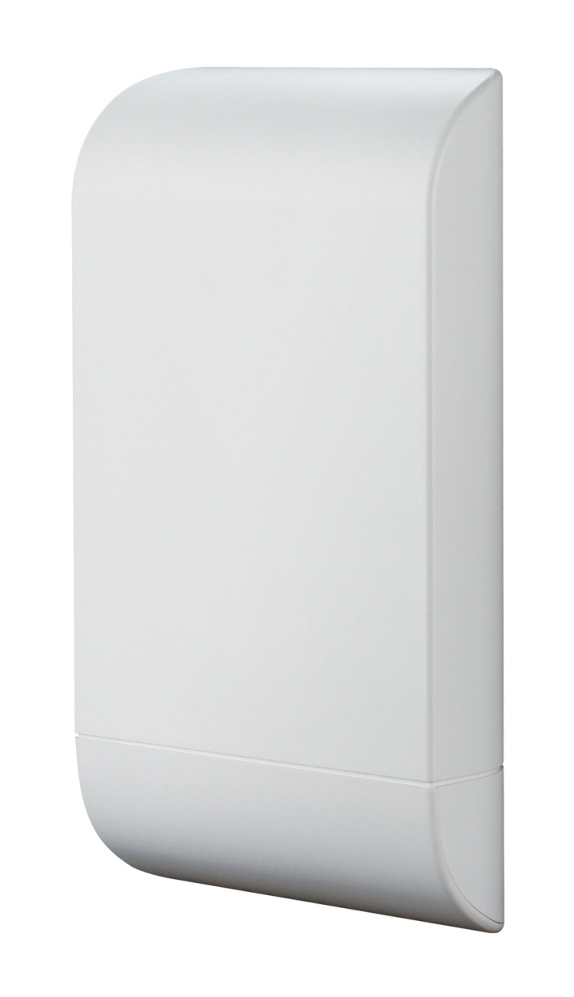
Product introduction
DAP-3310 (2.4GHz)/ DAP-3410 (5GHz)
Two 10/100 Fast Ethernet Port
Proprietary PoE Design
PoE Pass Through (up to 10watt)
High Gain Sector Antenna
Multiple Operation Modes
Advanced Business Features
IP65 Water/Dust-Proof
Support 15kV ESD Protection
* Limited warranty (1 year) and no D-Link after service

Slide 3
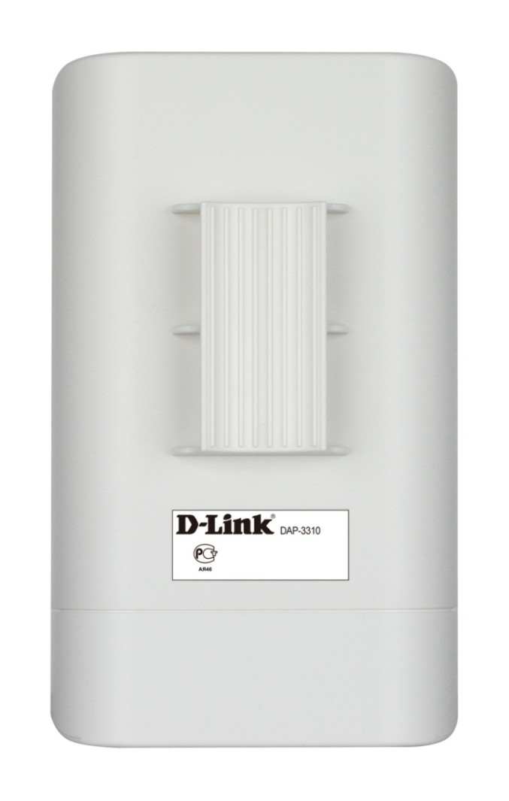
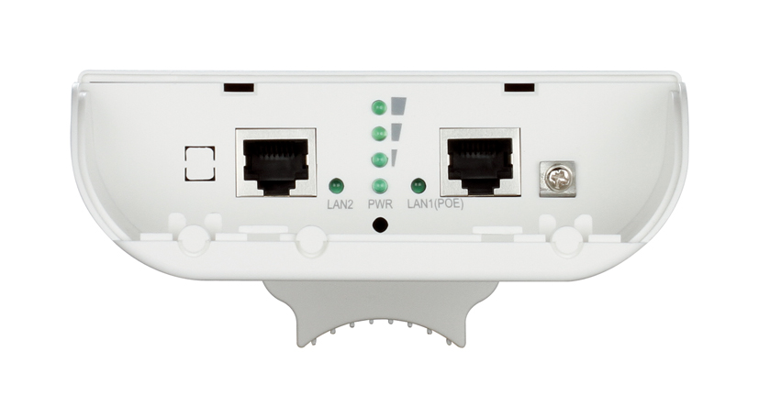
Product introduction
Pole Mount
Grounding
LAN2
LAN1 (PoE)
Reset

Slide 4
Selling Points

Slide 5
Main features
Long distance wireless networking.
Ideal solution for WDS and WISP.
- High power design to provide better wireless coverage
- Wireless speed up to 300M (2x2)
- Built-in High Gain Sector Antenna:10dBi (DAP-3310) /15dBi (DAP-3410)
- Weather-proof design (IP65)¹
- Support 15kV ESD protection³
Multiple operation modes.
Different mode for different scenario.
- Access Point / WDS² / WDS with AP² / Wireless Client / WISP Client Router / WISP Repeater
Total security.
Multiple types for different security level.
- WPA/WPA2-Personal/Enterprise
- WEP 64/128 bit Encryption
- 802.1X
IP65 standard means the device is protected from dust and low pressure jets of water from all directions - limited ingress permitted.
Cannot build WDS with current 11b/g APs and AirPremierN series APs.
With optional grounding wire

Slide 6
Advanced features
Advanced feature.
Supports various function for SMB need.
- Multiple SSID (up to 8) in AP mode and 8 VLANs for network segmentation
- Wi-Fi WMM
- QoS (Bandwidth Control)
- SNMP v1/v2c/v3, Web Management (http, https)
Firewall feature.
Protect your wireless data in SMB.
- MAC Address Filter
- Wireless LAN Partition
- User Limit
- DMZ, Virtual Server, Parental Control and IP routing⁴
3. DMZ, Virtual Server , Parental Control and IP routing only support in WISP client router and WISP repeater mode.

Slide 7
PoE Passthrough
PoE Passthrough.
A secondary Ethernet port with PoE output for IP-Camera.
WDS
PoE Output
Wired Device
Switch
Switch
Internet
4. Only support up to10watt IP surveillance, DCS-3716, DCS-6113, DCS-6511and DCS-7110

Slide 8
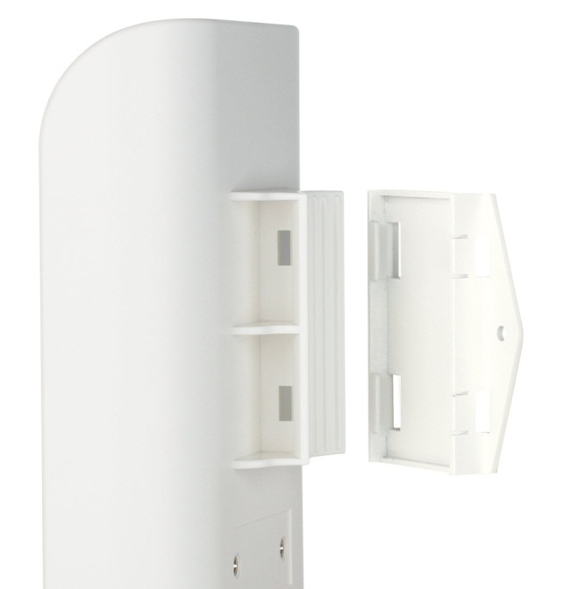
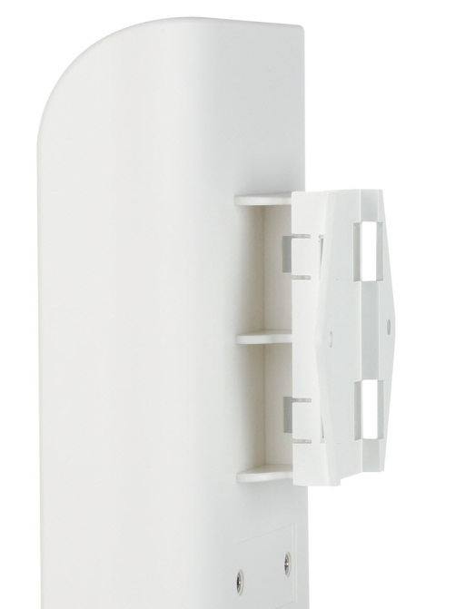
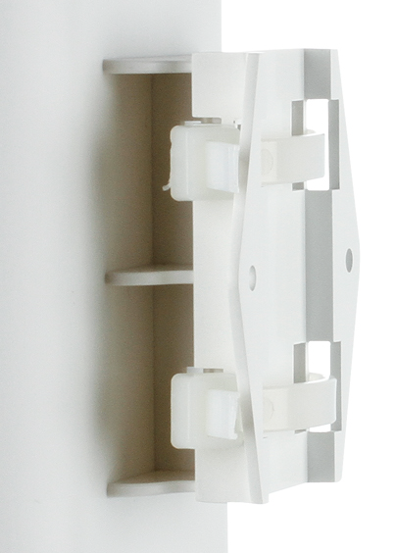
wall mount
Smart wall mount.
Three steps installation design, easy and quickly.
1
2
3
Click!
Wall
Mounting Tie
Mounting Tie
Screw wall mount⁵ on the wall first
5. Wall mount kit is include in package contents

Slide 9
PTP / PTMP Communication

Slide 10
Point To Point
PtP communication.
Provide different ways for long distance PtP link.
WDS
WISP
WDS
Office 1
WISP
Base Station
WDS
WISP
Office 2
Building

Slide 11
Point To Multi-Point
PtMP communication.
Up to 8 WDS link available for multi-point facilities deployment.
WDS (Up to 8)
Factory
IP CAM
Office
Warehouse

Slide 12
Multiple operation mode

Slide 13
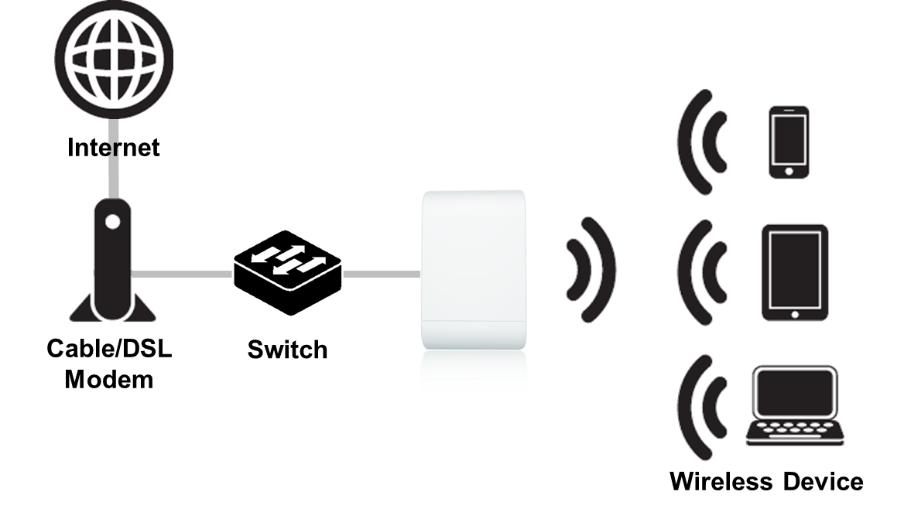
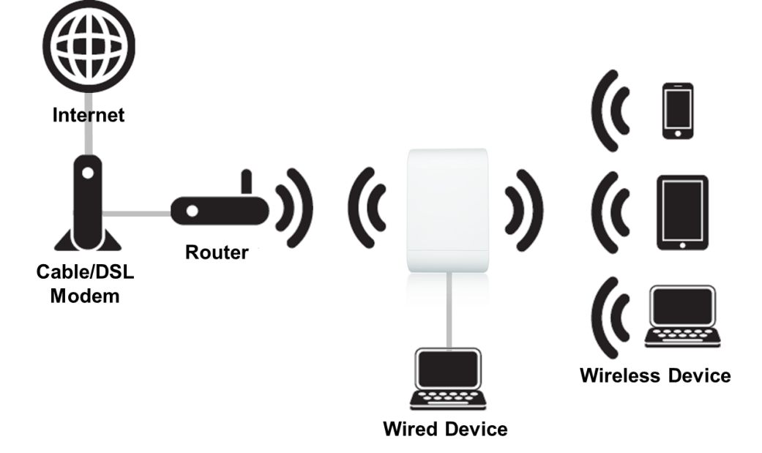
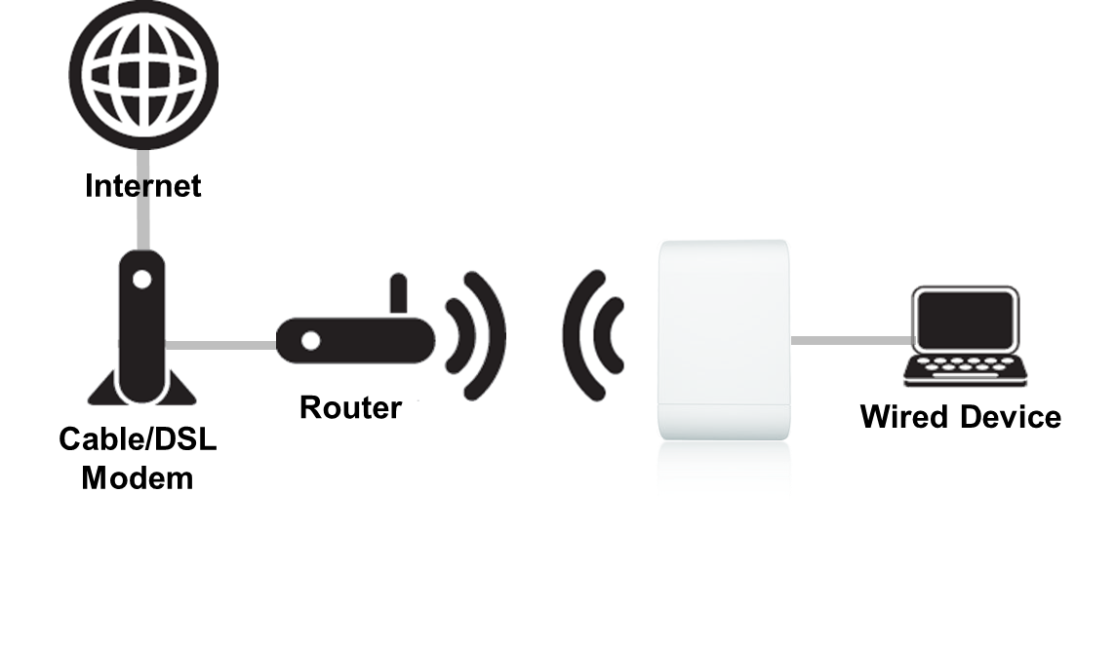
Different mode for different scenario
Access Point
Repeater
Wireless Client

Slide 14
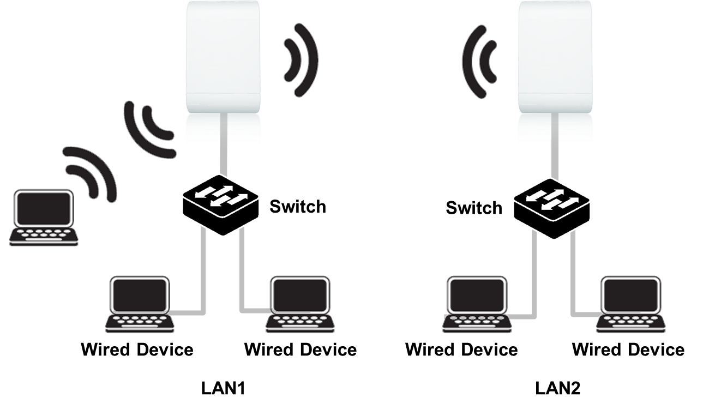
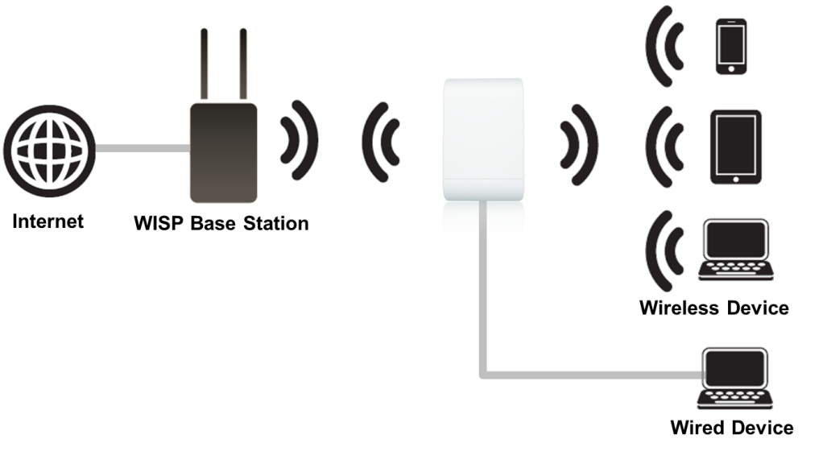
Different mode for different scenario
WDS
WISP

Slide 15
Competitive Analysis

Slide 16
How to fight with TP-Link TL-WA5210n
Brand | D-Link | TP-Link
Model | DAP-3310 | TL-WA5210G
Frequency Band | 2.4GHz | 2.4GHz
Data rate | 300Mbps (11n 2x2 design) | 54Mbps (11g design)
Operation mode | AP/WDS/WDS with AP/Client/Repeater/WISP | AP/Bridge/ Repeater/WISP client/Router
High power design | Support | Support
PoE pass through | Support | Not support(One 10/100 ethernet port only)
Embedded antenna | 10dBi | 12dBi
Multiple SSID | Support (up to 8) | Support (up to 4)
SNMP | V1/v2c/v3 | V1
Water/dust-proof | IP65 | Weather resist
ESD protection | 15KV (with optional grounding wire) | 15KV (with optional grounding wire)
Mounting kit | Wall/Pole | Pole
Power over ethernet | Proprietary 48V PoE | Proprietary 12V PoE

Slide 17
How to fight with TP-Link TL-WA5210n
High performance capability
DAP-3310 is 11n 2x2 300Mbps design that has better performance capability than TL-WA5210N(54Mbps)
Advanced feature.
The LAN2 interface of DAP-3310 can offer both of link connectivity and maximum 10W power for IP camera or access point that powered by PoE, The TL-WA5210N only has one LAN port and doesn’t have this feature.
Advanced business features provided
DAP-3310 offers more features such as 8 SSIDs and SNMP v3 support
IP65 grade exterior AP
DAP-3310 passed IP65 dust and waterproof testing criteria, the TL-WA5210N highlight it’s weatherproof AP only.
Wall mount
Wall mount kit offers flexible installation for customer who want to mount AP on the wall.

Slide 18
How to fight with TP-Link TL-WA7510n
Brand | D-Link | TP-Link
Model | DAP-3410 | TL-WA7510N
Frequency Band | 5GHz | 5GHz
Data rate | 300Mbps (11n 2x2 design) | 150Mbps (1x1 design)
Operation mode | AP/WDS/WDS with AP/Client/Repeater/WISP | AP/Bridge/ Repeater/WISP client/Router
High power design | Support | Support
PoE pass through | Support(LAN2) | Not support(One 10/100 interface only)
Embedded antenna | 15dBi | 15dBi
Multiple SSID | Support (up to 8) | Support (up to 4)
SNMP | V1/v2c/v3 | V1
Water/dust-proof | IP65 | Weather resist
ESD protection | 15KV (with optional grounding wire) | 15KV (with optional grounding wire)
Mounting kit | Wall/Pole | Pole
Power over Ethernet | Proprietary 48V PoE | Proprietary 12V PoE

Slide 19
How to fight with TP-Link TL-WA7510n
High performance capability
DAP-3410 is 11n 2x2 300Mbps design that has better performance capability than TL-WA7510N(150Mbps)
Advanced feature.
The LAN2 interface of DAP-3410 can offer both of link connectivity and maximum 10W power for IP camera or access point that powered by PoE, The TL-WA7510N only has one LAN port and doesn’t have this feature.
Advanced business features provided
DAP-3410 offers more features such as 8 SSIDs and SNMP v3 support
IP65 grade exterior AP
DAP-3410 passed IP65 dust and waterproof testing criteria, the TL-WA7510N highlight it’s weatherproof AP only.
Wall mount
Wall mount kit offers flexible installation for customer who want to mount AP on the wall.

Slide 20
How to fight with Engenius ENH202
Brand | D-Link | EnGenius
Model | DAP-3310 | ENH202
Frequency Band | 2.4GHz | 2.4GHz
Data rate | 300Mbps (11n 2x2 design) | 300Mbps (11n 2x2 design)
Operation mode | AP/WDS/WDS with AP/Client/Repeater/WISP | AP/WDS/WDS with AP/Client/WISP
High power design | Support | Support
PoE pass through | Support(LAN2) | N/A
Embedded antenna | 10dBi | 10dBi
Multiple SSID | Support (up to 8) | Support (up to 4)
SNMP | V1/v2c/v3 | V1/V2c
Water/dust-proof | IP65 | IP55
ESD protection | 15KV (with optional grounding wire) | N/A
Mounting kit | Wall/Pole | Pole
Power over Ethernet | Proprietary 48V PoE | Proprietary 24V PoE

Slide 21
How to fight with Engenius ENH202
PoE pass through for IP camera
The LAN2 interface of DAP-3310 can offer both of link connectivity and maximum 10W power for IP camera or access point that powered by PoE, The ENH202 only has one LAN port and doesn’t have this feature.
Advanced business features provided
DAP-3310 offers more features such as 8 SSIDs and SNMP v3 support
15KV ESD protection provided
DAP-3310 has one GND interface and it can have 15KV ESD protection with optional grounding wire
IP65 grade exterior AP
IP65 grade AP can offer better weather resistance capability than IP55 grade AP
Wall mount
Wall mount kit offers flexible installation for customer who want to mount AP on the wall.

Slide 22
How to fight with Engenius ENH500
Brand | D-Link | EnGenius
Model | DAP-3410 | ENH500
Frequency Band | 5GHz | 5GHz
Data rate | 300Mbps (11n 2x2 design) | 300Mbps (11n 2x2 design)
Operation mode | AP/WDS/WDS with AP/Client/Repeater/WISP | AP/WDS/WDS with AP/Client/WISP
High power design | Support | Support
PoE pass through | Support(LAN2) | N/A
Embedded antenna | 15dBi | 13dBi
Multiple SSID | Support (up to 8) | Support (up to 4)
SNMP | V1/v2c/v3 | V1/V2c
Water/dust-proof | IP65 | IP55
ESD protection | 15KV (with optional grounding wire) | N/A
Mounting kit | Wall/Pole | Pole
Power over Ethernet | Proprietary 48V PoE | Proprietary 24V PoE

Slide 23
How to fight with ENGENIUS ENH500
PoE pass through for IP camera
The LAN2 interface of DAP-3410 can offer both of link connectivity and maximum 10W power for IP camera or access point that powered by PoE, The ENH500 only has one LAN port and doesn’t have this feature.
Advanced business features provided
DAP-3410 offers more features such as 8 SSIDs and SNMP v3 support
15KV ESD protection provided
DAP-3410 has one GND interface and it can have 15KV ESD protection with optional grounding wire
IP65 grade exterior AP
IP65 grade AP can offer better weather resistance capability than IP55 grade AP
Wall mount
Wall mount kit offers flexible installation for customer who want to mount AP on the wall.

Slide 24
How to fight with Ubiquiti nano station m2
Brand | D-Link | Ubiquiti
Model | DAP-3310 | Nano station M2
Frequency Band | 2.4GHz | 2.4GHz
Data rate | 300Mbps (11n 2x2 design) | 300Mbps (11n 2x2 design)
Operation mode | AP/WDS/WDS with AP/Client/Repeater/WISP | AP/WDS/WDS with AP/Client/Repeater/WISP/Router
High power design | Support | Support
PoE pass through | Support | Support
Embedded antenna | 10dBi | 11dBi
Multiple SSID | Support (up to 8) | N/A
SNMP | V1/v2c/v3 | V1
Water/dust-proof | IP65 | Weather resist
ESD protection | 15KV (with optional grounding wire) | N/A
Mounting kit | Wall/Pole | Pole
Power over Ethernet | Proprietary 48V PoE | 24V PoE

Slide 25
How to fight with Ubiquiti nano station m2
Advanced business features provided
DAP-3310 offers more features such as 8 SSIDs and SNMP v3 support
15KV ESD protection provided
DAP-3310 has one GND interface and it can have 15KV ESD protection with optional grounding wire
IP65 grade exterior AP
DAP-3310 passed IP65 dust and waterproof testing criteria, the Nano Station M5 highlight it’s weatherproof AP only.
Wall mount
Wall mount kit offers flexible installation for customer who want to mount AP on the wall.

Slide 26
How to fight with Ubiquiti nano station m5
Brand | D-Link | Ubiquiti
Model | DAP-3410 | Nano station M5
Frequency Band | 5GHz | 5GHz
Data rate | 300Mbps (11n 2x2 design) | 300Mbps (11n 2x2 design)
Operation mode | AP/WDS/WDS with AP/Client/Repeater/WISP | AP/WDS/WDS with AP/Client/Repeater/WISP/Router
High power design | Support | Support
PoE pass through | Support | Support
Embedded antenna | 15dBi | 16dBi
Multiple SSID | Support (up to 8) | N/A
SNMP | V1/v2c/v3 | V1
Water/dust-proof | IP65 | Weather resist
ESD protection | 15KV (with optional grounding wire) | N/A
Mounting kit | Wall/Pole | Pole
Power over ethernet | Proprietary 48V PoE | Proprietary 24V PoE

Slide 27
How to fight with Ubiquiti nano station m5
Advanced business features provided
DAP-3410 offers more features such as 8 SSIDs and SNMP v3 support
15KV ESD protection provided
DAP-3410 has one GND interface and it can have 15KV ESD protection with optional grounding wire
IP65 grade exterior AP
DAP-3410 passed IP65 dust and waterproof testing criteria, the Nano Station M5 highlight it’s weatherproof AP only.
Wall mount
Wall mount kit offers flexible installation for customer who want to mount AP on the wall.

Slide 28
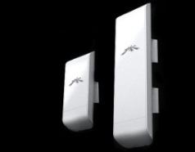
Comparison tABlE
Brand | D-Link | TP-Link | EnGenius | Ubiquiti
Model | DAP-3310/DAP-3410 | TL-WA5210G/TL-WA7510N | ENH202/ENH500 | Nano station M2/M5
Frequency Band | 2.4GHz/5GHz | 2.4GHz/5Ghz | 2.4GHz/5GHz | 2.4GHz/5GHz
Data rate | 300Mbps (11n 2x2 design) | 54Mbps (11g design) | 300Mbps (11n 2x2 design) | 300Mbps (11n 2x2 design)
Operation mode | AP/WDS/WDS with AP/Client/Repeater/WISP | AP/Bridge/ Repeater/WISP client/Router | AP/WDS/WDS with AP/Client/WISP | AP/WDS/WDS with AP/Client/Repeater/WISP/Router
High power design | Support | Support | Support | Support
PoE pass through | Support | N/A | N/A | Support
Build-in antenna | 10dBi/15dBi | 12dBi/15dBi | 10dBi/13dBi | 11dBi/16dBi
Multiple SSID | Support (up to 8) | Support (up to 4) | Support (up to 4) | N/A
SNMP | V1/v2c/v3 | V1 | V1/V2c | V1
Water/dust-proof | IP65 | Weather resist | IP55 | Weather resist
ESD protection | 15KV (with optional grounding wire) | 15KV (with optional grounding wire) | N/A | N/A
Mounting kit | Wall/Pole | Pole | Pole | Pole
PoE | Proprietary 48V PoE | Proprietary 12V PoE | Proprietary 24V PoE | Proprietary 24V PoE

