Slide 1
Asymmetric VLAN with DAP

Slide 2
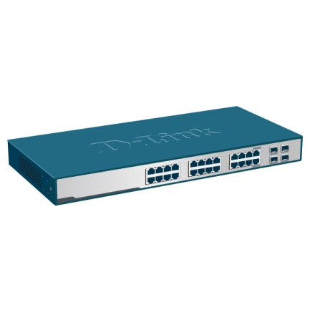
Asymmetric VLAN
Defining Asymmetric VLAN
  The device configuration allows a port to be defined as an untagged member only in one VLAN and tagged in multiple VLANs. By enabling Asymmetric VLAN on the device, a port is defined as an untagged member in multiple VLANs.
Private
VLAN 10
Public
VLAN 20
VLAN 1
Sever
VLAN 1

Slide 3
Asymmetric VLAN
Asymmetric VLAN Layer 2 Application.
  To share the server resource(file server, mail server…) for multi group (VLAN), but each group cannot access each other.
Private
VLAN 10
Public
VLAN 20
VLAN 1
Sever
VLAN 1
  VLAN 10 and VLAN 20 both can access the VLAN 1
  VLAN 10 and VLAN 20 cannot access each other

Slide 4
Scenario

Slide 5
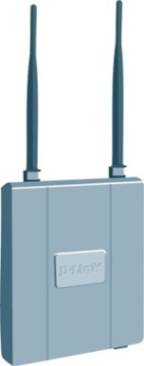
Asymmetric VLAN with DAP
Asymmetric VLAN Application.
  VLAN 10 and VLAN 20 both can access the VLAN 1
  VLAN 10 and VLAN 20 cannot access each other
Private
VLAN 10
Public
VLAN 20
PC 1
Private
VLAN 10
Public
VLAN 20
VLAN 1
PC 2
Sever
VLAN 1

Slide 6
Configuration

Slide 7

Asymmetric VLAN with DAP
Using DGS-1210-48 to create VLAN 1, VLAN 10 and VLAN 20, and asymmetric VLAN enabled.
  VLAN 10 and VLAN 20 both can access the VLAN 1, and it own VALN
  VLAN 10 and VLAN 20 both cannot access each other
Private
VLAN 10
Public
VLAN 20
PC 1
Private
VLAN 10
Public
VLAN 20
VLAN 1
AP connect to Port 15
PC 2
Sever
VLAN 1
Sever connect to Port 13

Slide 8
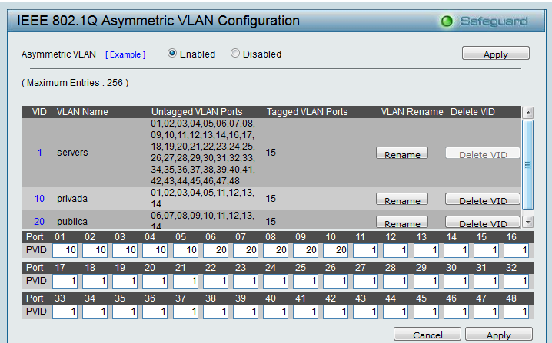
Switch configuration
DGS-1210-48 configuration
  VLAN 10 : port 1~5, and 11~15, port 15 with tag
  VLAN 20 : port 6~10, and 11~15, port 15 with tag
  VLAN 1 : port 1~48, port 15 with tag

Slide 9
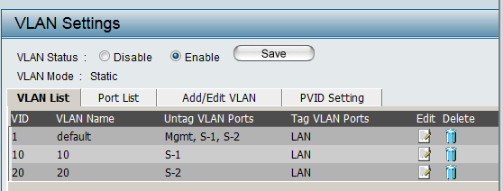
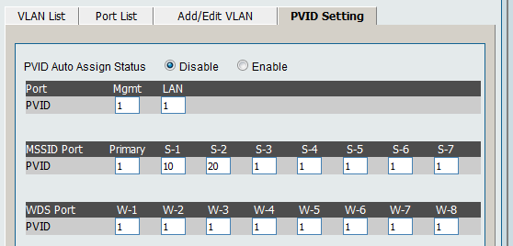
DAP configuration
DAP-2360 configuration
  VLAN 10 : S-1, ethernet port with tag
  VLAN 20 : S-2, ethernet port with tag
  VLAN 1 : Mgmt, LAN, S-1, S-2, ethernet port with tag
Primary SSID | dlink | 2.4 GHz | None
Multi-SSID1 | privada-1 | 2.4 GHz | None
Multi-SSID2 | publica-1 | 2.4 GHz | None
Index | SSID | Band | Encryption | Delete

Slide 10
Verifying

Slide 11
Asymmetric VLAN with DAP
Testing results,
  PC 1 can access the Server VLAN 1 and the computers under VLAN 10, but not the computers under VALN 20
  PC 2 can access the Server VLAN 1 and the computers under VLAN 20, but not the computers under VALN 10
Private
VLAN 10
Public
VLAN 20
PC 1
Private
VLAN 10
Public
VLAN 20
VLAN 1
AP connect to Port 15
PC 2
Sever
VLAN 1
Sever connect to Port 13

Slide 12
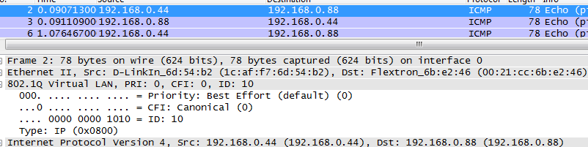

Asymmetric VLAN with DAP
Testing results,
  PC 1 ping to Sever and VLAN 10 PC with VLAN tag 10, sniffer from LAN of AP
Public
VLAN 20
Private
VLAN 10
Private
VLAN 10
PC 1
192.168.0.44
Public
VLAN 20
VLAN 1
AP connect to Port 15
Sever
192.168.0.88
VLAN 1
PC 2
192.168.0.55
Sever connect to Port 13

Slide 13
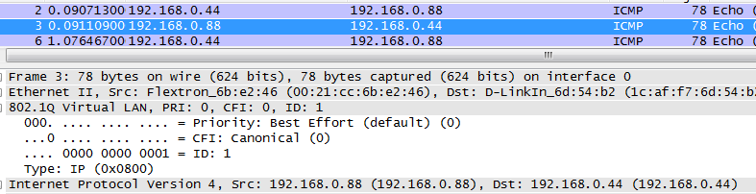
Asymmetric VLAN with DAP
Testing results,
  Sever reply the ping to PC1 with VLAN tag 1, sniffer from LAN of AP
Public
VLAN 20
Private
VLAN 10
Private
VLAN 10
PC 1
192.168.0.44
Public
VLAN 20
VLAN 1
AP connect to Port 15
Sever
192.168.0.88
VLAN 1
PC 2
192.168.0.55
Sever connect to Port 13

Slide 14
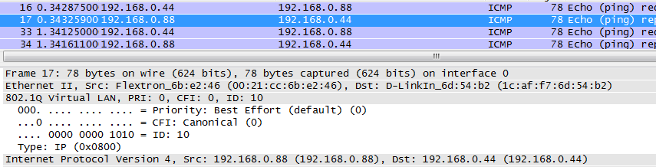
Asymmetric VLAN with DAP
Testing results,
  VLAN 10 PC reply the ping to PC1 with VLAN tag 10, sniffer from LAN of AP
Public
VLAN 20
Private
VLAN 10
Private
VLAN 10
PC 1
192.168.0.44
Public
VLAN 20
VLAN 1
AP connect to Port 15
Sever
192.168.0.88
VLAN 1
PC 2
192.168.0.55
Sever connect to Port 13

Slide 15
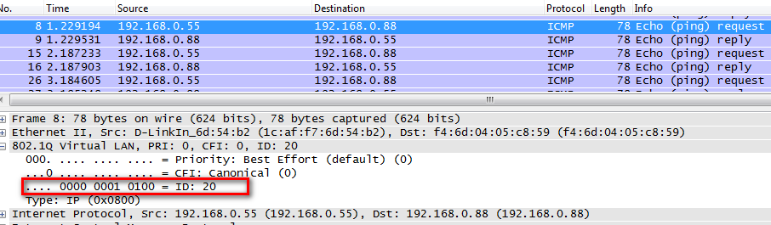
Asymmetric VLAN with DAP
Testing results,
  PC 2 ping to Sever and VLAN 20 PCs with VLAN tag 20, sniffer from LAN of AP
Public
VLAN 20
Private
VLAN 10
Private
VLAN 10
PC 1
192.168.0.44
Public
VLAN 20
VLAN 1
AP connect to Port 15
Sever
192.168.0.88
VLAN 1
PC 2
192.168.0.55
Sever connect to Port 13

Slide 16
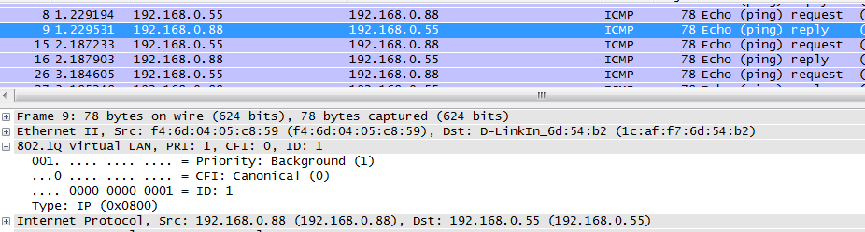
Asymmetric VLAN with DAP
Testing results,
  Server reply ping to PC 2 with VLAN tag 1, sniffer from LAN of AP
Public
VLAN 20
Private
VLAN 10
Private
VLAN 10
PC 1
192.168.0.44
Public
VLAN 20
VLAN 1
AP connect to Port 15
Sever
192.168.0.88
VLAN 1
PC 2
192.168.0.55
Sever connect to Port 13

Slide 17
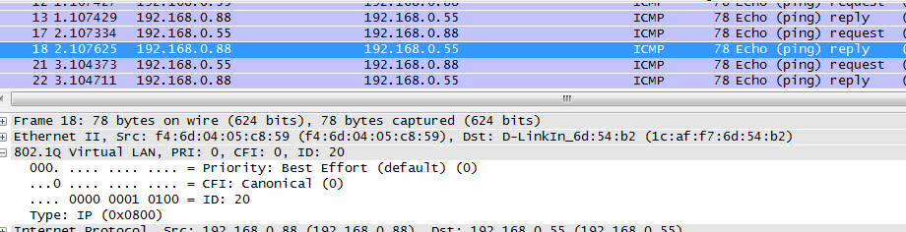
Asymmetric VLAN with DAP
Testing results,
  VLAN 20 PC reply ping to PC 2 with VLAN tag 20, sniffer from LAN of AP
Public
VLAN 20
Private
VLAN 10
Private
VLAN 10
PC 1
192.168.0.44
Public
VLAN 20
VLAN 1
AP connect to Port 15
Sever
192.168.0.88
VLAN 1
PC 2
192.168.0.55
Sever connect to Port 13

Slide 18
Reference

Slide 19
Case reference,
  DLA20130606000001
  HQ20130614000003
  HQ20130618000006
  HQ20130704000009

